Slide 1
Part 1: overview
Principal Component Analysis (PCA)
Partial Least Squares (PLS)
Two-way Orthogonal PLS (O2PLS)
Population model
Multi-omics data integration
Group sparse O2PLS
Post-hoc analyses using external databases
Notes:
Theory 5 – 10 min
Data

Slide 2
Introduction
We have seen PCA and PLS
Looked at them from an algorithmic point of view
What is the underlying population model?
What are the random variables, and what are the parameters?

Slide 3
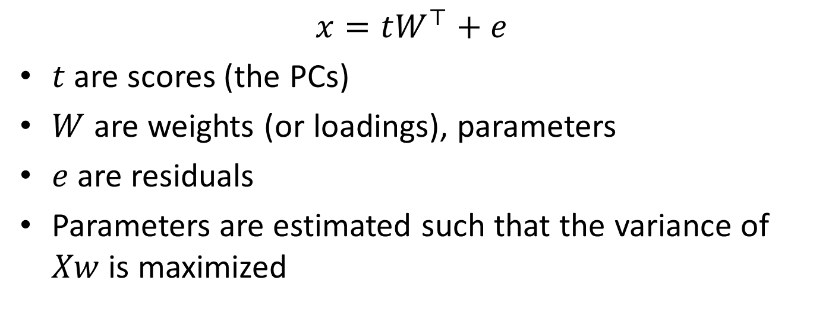
Population model for PCA
$$x=tW^{⊤}+e$$
$t$ are scores (the PCs)
$W$ are weights (or loadings), parameters
$e$ are residuals
Parameters are estimated such that the variance of $Xw$ is maximized
Notes:
Use diagram, graph model

Slide 4
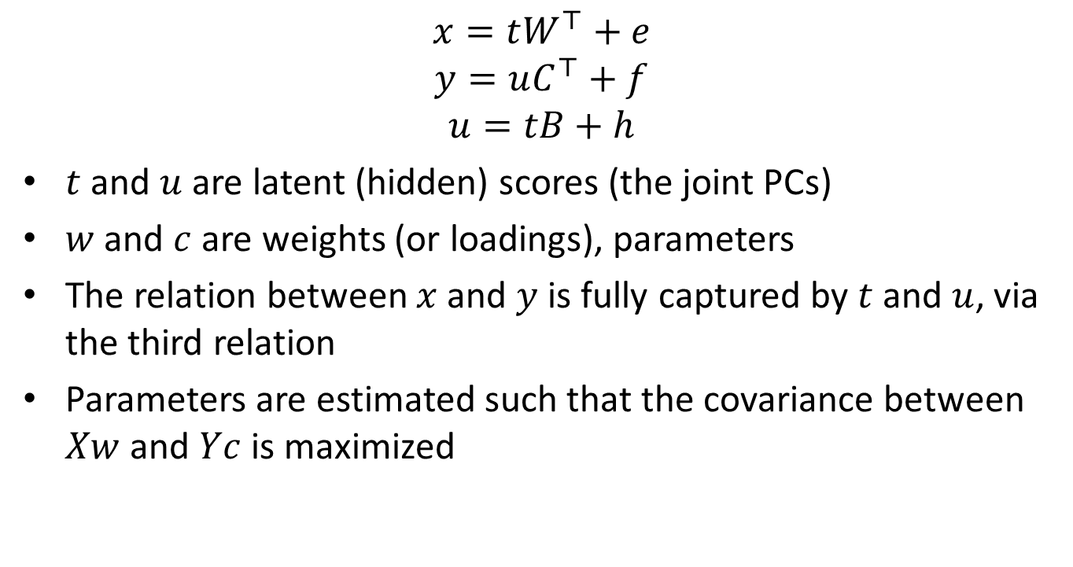
Population model for PLS
$$x=tW^{⊤}+e$$
$$y=uC^{⊤}+f$$
$$u=tB+h$$
$t$ and $u$are latent (hidden) scores (the joint PCs)
$w$ and $c$ are weights (or loadings), parameters
The relation between $x$ and $y$ is fully captured by $t$ and $u$, via the third relation
Parameters are estimated such that the covariance between $Xw$ and $Yc$ is maximized

Slide 5
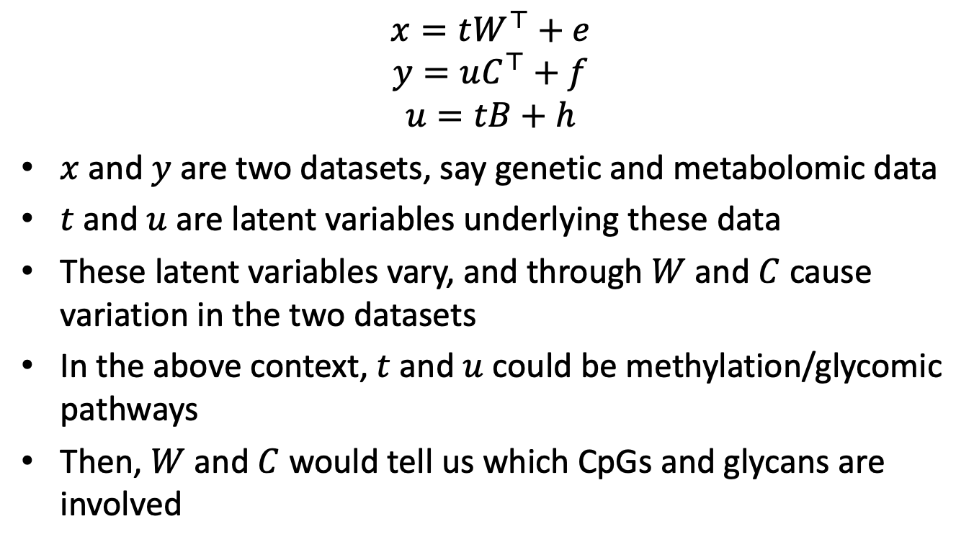
Interpretation of the model
$$x=tW^{⊤}+e$$
$$y=uC^{⊤}+f$$
$$u=tB+h$$
$x$ and $y$ are two datasets, say genetic and metabolomic data
$t$ and $u$ are latent variables underlying these data
These latent variables vary, and through $W$ and $C$ cause variation in the two datasets
In the above context, $t$ and $u$ could be methylation/glycomic pathways
Then, $W$ and $C$ would tell us which CpGs and glycans are involved

Slide 6
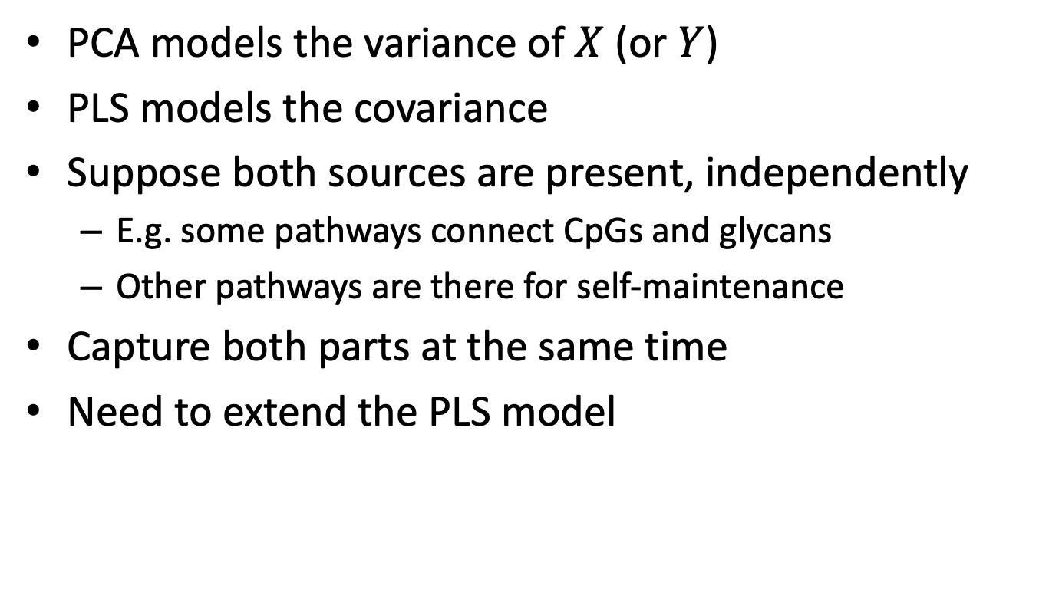
Omics-specific variation
PCA models the variance of $X$ (or $Y$)
PLS models the covariance
Suppose both sources are present, independently
E.g. some pathways connect CpGs and glycans
Other pathways are there for self-maintenance
Capture both parts at the same time
Need to extend the PLS model

Slide 7
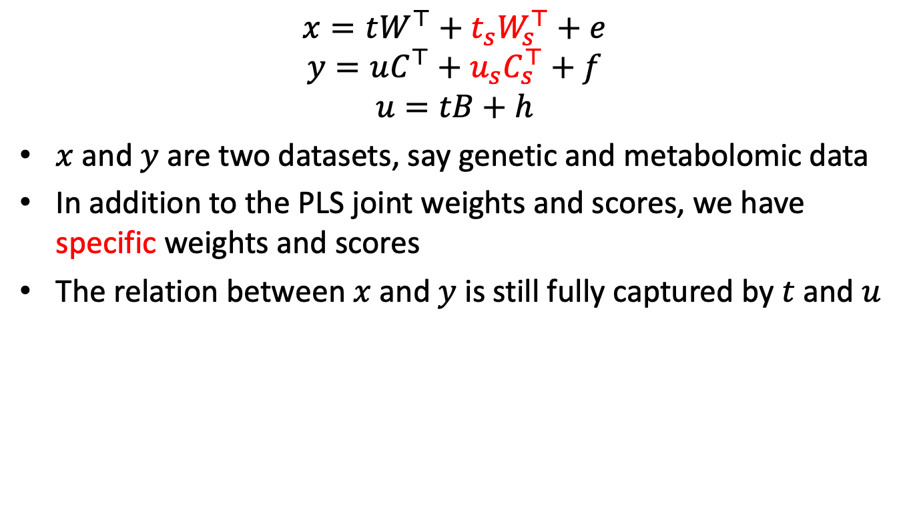
O2PLS model and data-specific parts
$$x=tW^{⊤}+t_{s}W_{s}^{⊤}+e$$
$$y=uC^{⊤}+u_{s}C_{s}^{⊤}+f$$
$$u=tB+h$$
$x$ and $y$ are two datasets, say genetic and metabolomic data
In addition to the PLS joint weights and scores, we have specific weights and scores
The relation between $x$ and $y$ is still fully captured by $t$ and $u$

Slide 8
Estimating the O2PLS components
Three step estimation
First estimate several PLS components, they will contain both joint and specific parts
From that, estimate specific parts only and subtract
Finally, estimate again PLS on the “corrected” data
Implemented and on CRAN: OmicsPLS
Obtain loadings with: loadings
Obtain scores with: scores
Notes:
package

Slide 9
Number of components
Until now, we did not mention how to find out the number of components needed
For PCA, this number is the number of PCs
For PLS, this is the number of joint PCs
For O2PLS, this is
The number of joint PCs
And the number of X-specific components
And Y-specific components
Standard way is to do cross-validation (details: next session)

Slide 10
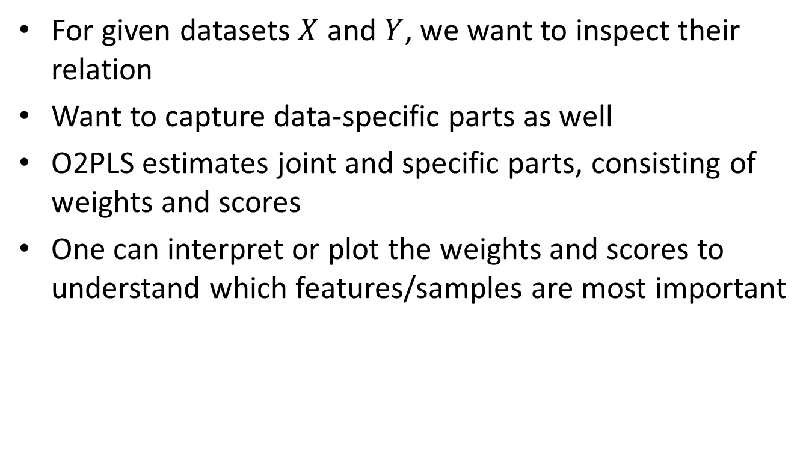
O2PLS: summary
For given datasets $X$ and $Y$, we want to inspect their relation
Want to capture data-specific parts as well
O2PLS estimates joint and specific parts, consisting of weights and scores
One can interpret or plot the weights and scores to understand which features/samples are most important

Slide 11
Exercises
Load the Down Syndrome data and run PCA to obtain the first principal component of the glycans
svd(glycomics, nu=0, nv=1)$v
Now run o2m using both methylation and glycomics data and obtain the first joint principal component
fit <- o2m(methylation, glycomics, 2, 4, 6)
loadings(fit, "Yj", subset=1)
Compare the two loading vectors
Notes:
20 – 30 min

Slide 12
Part 1: overview
Principal Component Analysis (PCA)
Partial Least Squares (PLS)
Two-way Orthogonal PLS (O2PLS)
Population model
Multi-omics data integration
Group sparse O2PLS
Post-hoc analyses using external databases
Notes:
Theory 5 – 10 min
Data

